Slide 1
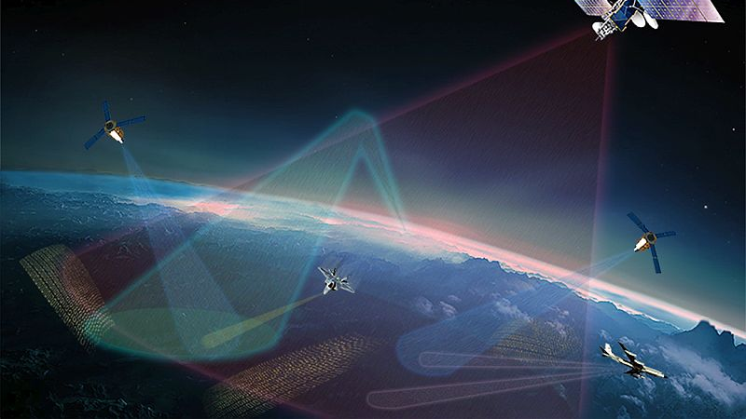
Lesson 2 Part 2
Introduction to the Space Environment
Earth-Sun Relationship

Slide 2
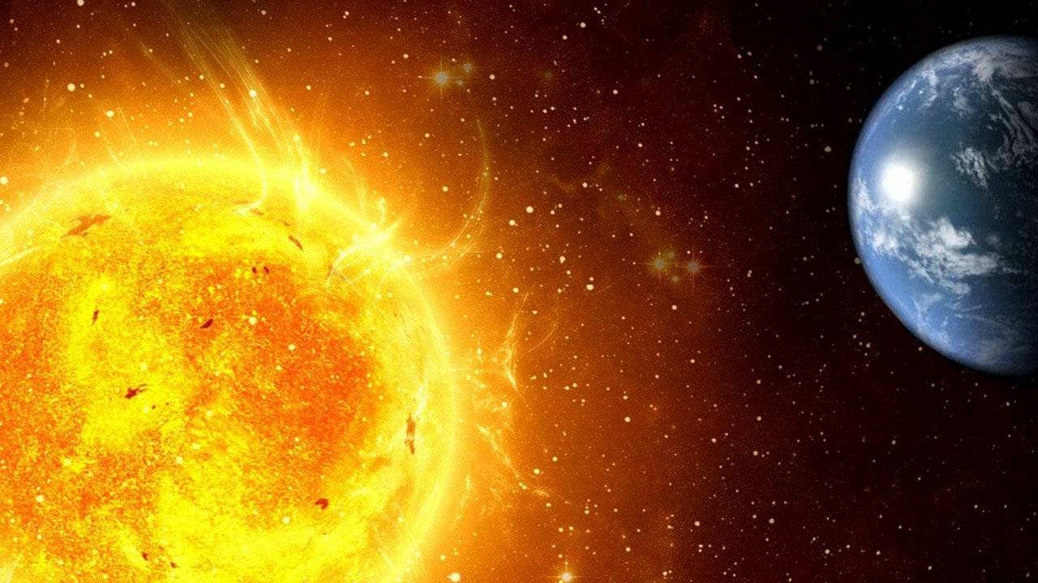
20 – 25% of all spacecraft failures are related to interactions with the space environment

Slide 3
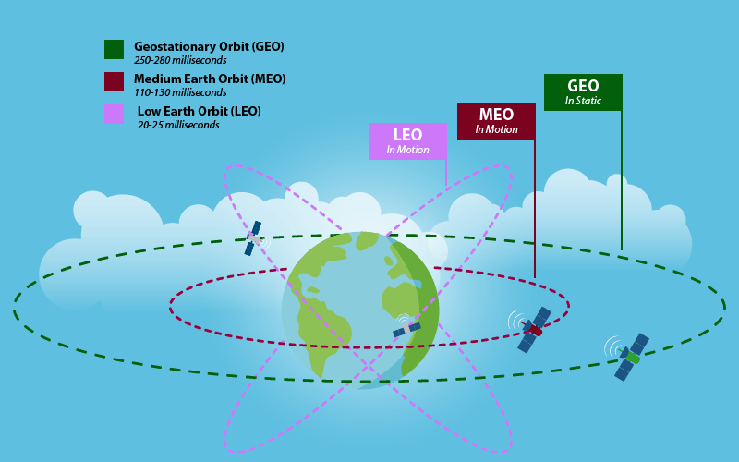
ALTITUDE

Slide 4
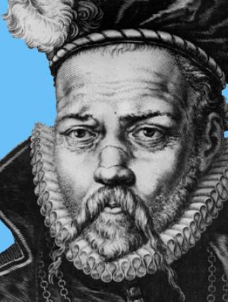
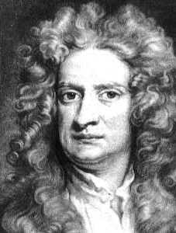
Orbital Motion Laws

Slide 5
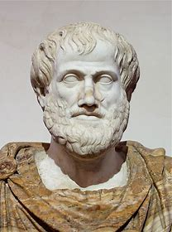
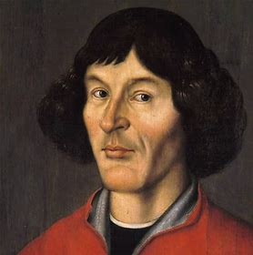
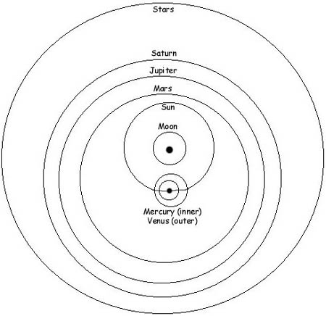
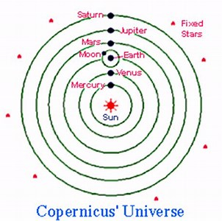
ARISTOTLE
COPERNICUS
EARLY ASTRONOMERS

Slide 6
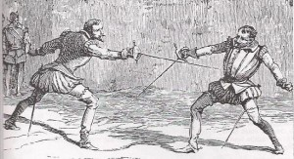
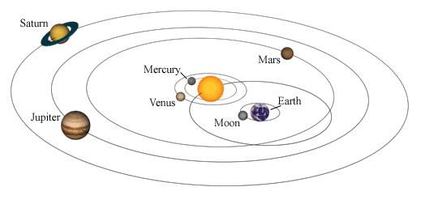
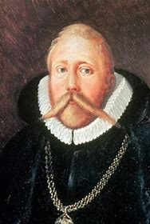
TYCHO BRAHE
Observational astronomy

Slide 7
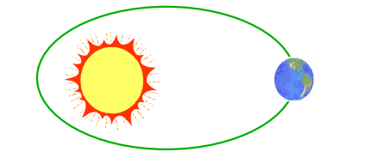

JOHANNES KEPLER
The orbits of planets are ellipses with the sun at one focus.
2. The line joining a planet to the sun sweeps out equal areas in equal times.
3. The square of an orbit’s period is proportional to the cube of the average distance between the planet and the sun.
$P=2π\sqrt{\frac{a^{3}}{μ}}$
periapsis
apoapsis
2a
P = period
a = semi-major axis
μ = gravitational constant

Slide 8
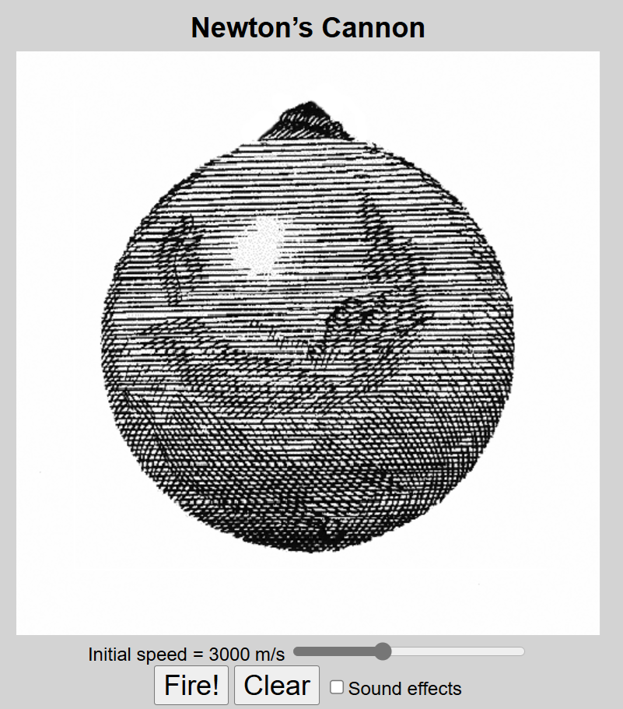
ISAAC NEWTON
1st Law: A body continues in its state of rest, or uniform motion, unless compelled to change that state by force impressed upon it.
Relevance:
1) There must be a force on satellites – gravity
2) Momentum is conserved – orbits are constant (orientation and size)

Slide 9

Isaac Newton
2nd Law: The time rate of change of an object’s momentum is equal to the applied force.
$$\sum{\overset{⃑}{F }= \frac{Δ\overset{⃑}{p}}{∆t} }$$
But wait! Isn’t this law just F=ma?
NO!
Only under
certain conditions.

Slide 10


Newton’s 2nd Law (cont)
So:
$$\overset{⃑}{F}=m\overset{⃑}{a}$$
Only if mass doesn’t change!
Relevance:
We will use this law to derive the two-body equation of motion that describes orbital motion
In rockets, $\frac{∆m}{∆t}\overset{⃑}{V}≠0$ → this is the thrust term!

Slide 11
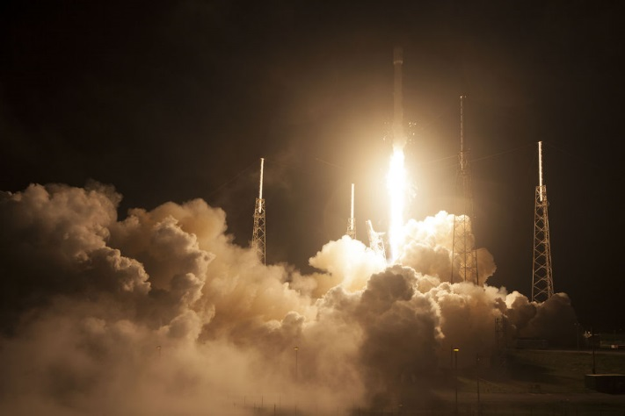
Newton’s 3rd Law
For every action there is an equal and opposite reaction.
Relevance: Rockets!

Slide 12
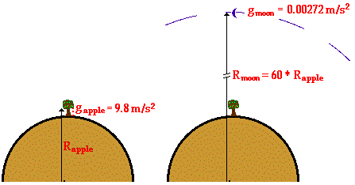

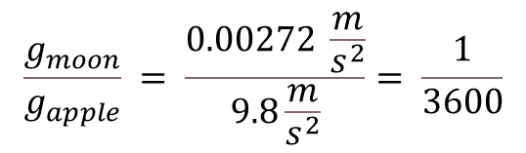
Newton’s Universal Law of Gravitation
$$\frac{g_{moon}}{g_{apple}} = \frac{0.00272 \frac{m}{s^{2}}}{9.8\frac{m}{s^{2}}}= \frac{1}{3600}$$
$$F_{g}= \frac{Gm_{1}m_{2}}{R^{2}}$$
$$Where:$$
$$F_{g}=force due to gravity$$
$$G=universal gravitational constant=6.67x{10}^{−11} \frac{N m^{2}}{{kg}^{2}}$$
$$m_{1} \&{ m}_{2} =masses$$
$$R=distance between the two objects$$

Slide 13
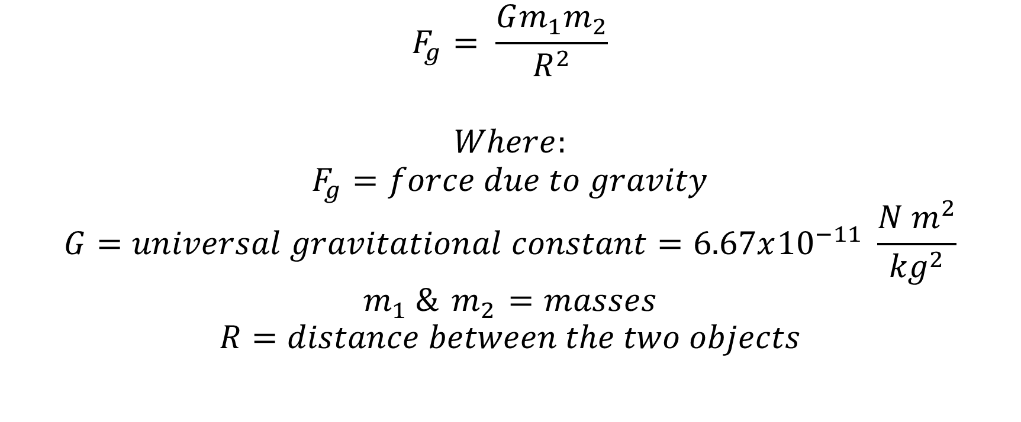
Newton’s Universal Law of Gravitation
$$F_{g}= \frac{Gm_{1}m_{2}}{R^{2}}$$
$$Where:$$
$$F_{g}=force due to gravity$$
$$G=universal gravitational constant=6.67x{10}^{−11} \frac{N m^{2}}{{kg}^{2}}$$
$$m_{1} \&{ m}_{2} =masses$$
$$R=distance between the two objects$$

Slide 14

Newton’s Universal Law of Gravitation
But we are going to define a new constant:
$$μ=G m_{e }=398600.5 \frac{{km}^{3}}{s^{2}}$$
Where:
$$m_{e}=mass of the earth$$
$$m_{s}=mass of the satellite$$
$$μ=Earth^{′}s gravitational constant$$
So
$$F_{g}= \frac{μm_{s}}{R^{2}}$$

Slide 15
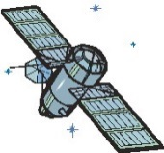
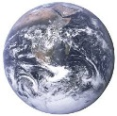

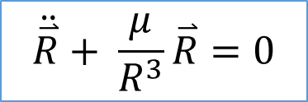
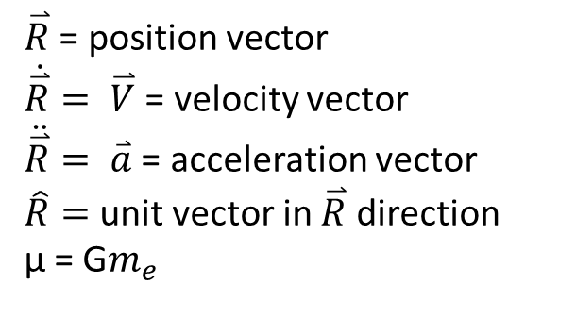
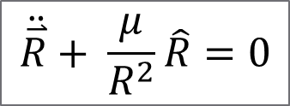

2 BODY EQUATION OF MOTION (EOM)
$$\hat{R}$$
Derivation not shown here
$$\ddot{\overset{⃑}{R}}+ \frac{μ}{R^{2}}\hat{R}=0$$
$${\overset{⃑}{F}}_{g}$$
$\overset{⃑}{R}$ = position vector
$\dot{\overset{⃑}{R}}= \overset{⃑}{V}$ = velocity vector
$\ddot{\overset{⃑}{R}}= \overset{⃑}{a}$ = acceleration vector
$\hat{R}=$ unit vector in $\overset{⃑}{R}$ direction
μ = G$m_{e}$
Alternate form:
$$\ddot{\overset{⃑}{R}}+ \frac{μ}{R^{3}}\overset{⃑}{R}=0$$

Slide 16





SOLUTION TO 2 BODY EOM
$$R= \frac{a(1−e^{2})}{1+ecosν}$$
$$\overset{⃑}{V}$$
φ
$$\overset{⃑}{R}$$
ν
apogee
$$\overset{⃑}{e}$$
$$°$$
perigee
F’
F
2a

Slide 17

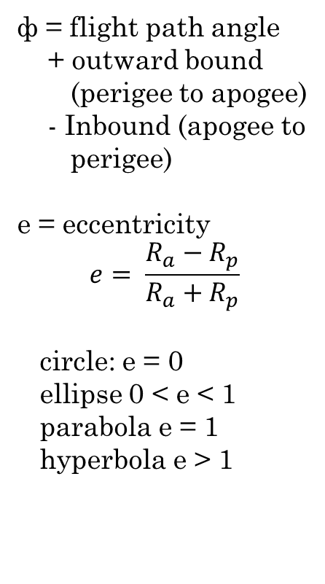


SOLUTION TO 2 BODY EOM
$$\overset{⃑}{V}$$
φ
ф = flight path angle
+ outward bound
(perigee to apogee)
- Inbound (apogee to
perigee)
e = eccentricity
$$e= \frac{R_{a}−R_{p}}{R_{a}+R_{p}}$$
circle: e = 0
ellipse 0 < e < 1
parabola e = 1
hyperbola e > 1
$$\overset{⃑}{R}$$
ƴ
apogee
$$\overset{⃑}{e}$$
$$°$$
perigee
F’
F
2a
$$r_{a}$$
$$r_{p}$$
c

Slide 18
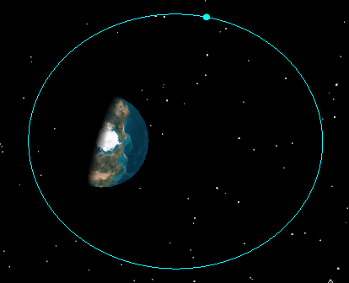
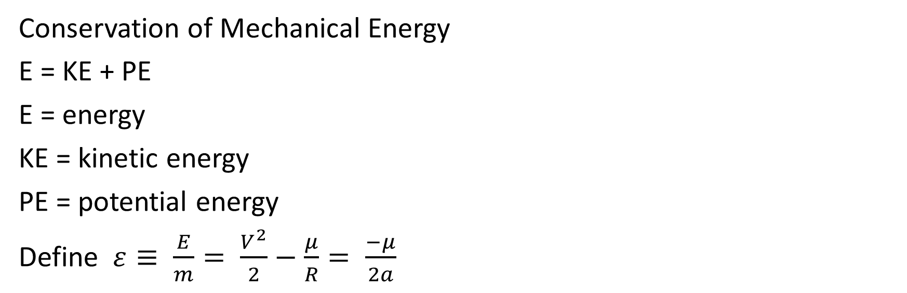
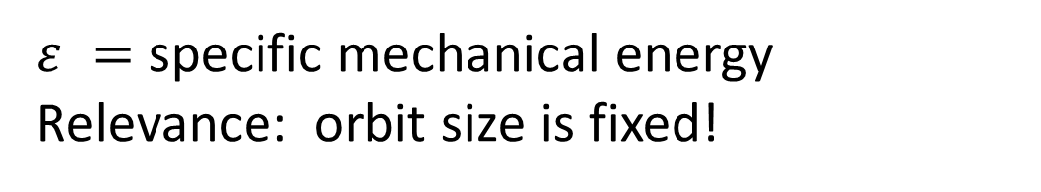
Energy Considerations
Conservation of Mechanical Energy
E = KE + PE
E = energy
KE = kinetic energy
PE = potential energy
Define $ε≡ \frac{E}{m}= \frac{V^{2}}{2}−\frac{μ}{R}= \frac{−μ}{2a}$
KE highest
PE lowest
KE lowest
PE highest
KE PE constant!
$ε =$ specific mechanical energy
Relevance: orbit size is fixed!

Slide 19
Energy Considerations
PE is defined differently than we’re used to seeing
It is defined negative inside the Earth’s sphere of influence (SOI) and equal to zero at the very edge of the SOI
ε = 0
PE = 0
ε > 0
PE = 0
ε < 0
PE < 0
Earth’s SOI ~ 1,000,000 km
(not to scale)

Slide 20
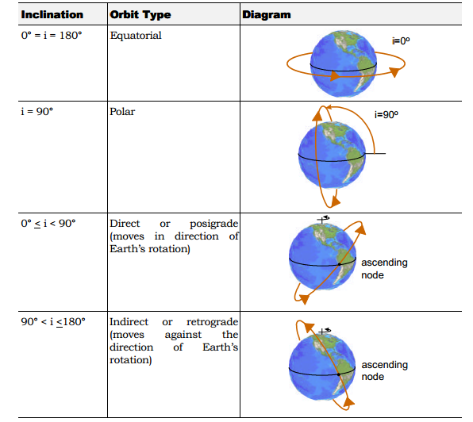

Slide 21
Possible Launch Sites
Kodiak Island
South Latitude North
Sea Launch
East Longitude West
SMAD, Fig 18.6
(Note: Sea launch can be on the equator or near the pole as required for a minimum energy launch.)
Launch site coordinates are identified in SMAD, Table 18.6.
Notes:
Δv_{EARTH} = 464.5 cos(Lat) m/s
These 17 or so sights have some or can do orbital launches. The location of the launch site and range safety considerations determine the acceptable launch azimuths.
Launch campaign logistics is also important. Some launch sites are remote and lack support infrastructure. World launch sites are shown in Figure 18.1. At such launch sites, a roll of duct tape can cost thousands of dollars, when we factor in the acquisition difficulty. Finally, the availability of downrange tracking assets is a factor in selecting a launch system. If the mission requires monitoring or commanding during the early phases of deployment, then the relative position of the launch site, the insertion point, and the downrange tracking asset are critical.

Slide 22
Orbit Inclinations and Launch Azimuths Available from the Eastern and Western Ranges
Vandenberg Air Force Base
Kennedy Space Center
38
30
36
29
34
Latitude, deg N
Latitude, deg N
28
32
27
30
26
124
122
120
118
116
84
82
80
78
76
Longitude, deg W
Longitude, deg W
SMAD, Fig 18.7
Notes:
Each launch site has a characteristic range of inclinations that it can support. For example, launches from Vandenberg can insert to inclinations ranging from the high 50s to slightly less than 110 degrees. The Vandenberg, Kennedy, and Wallops launch sites are shown in Figure 18.2.
Missions near the limits of these launch fans shown in Figure 18.2introduce additional constraints. For example, Vandenberg can launch to 56°, but doing so requires expensive evacuations. Wallops Island can achieve Sun synchronous orbits by overflying Cuba and the Isthmus of Panama, but for political reasons has never done so. The lesson here is to investigate all launch azimuth fans.

Slide 23
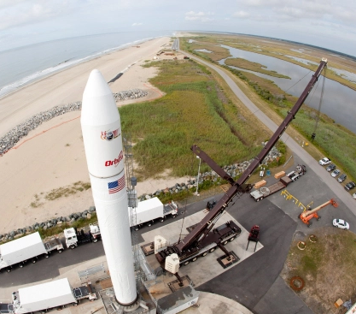
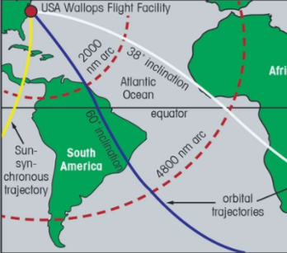
Orbit Inclinations and Launch Azimuths Available from Wallops
Notes:
Each launch site has a characteristic range of inclinations that it can support. For example, launches from Vandenberg can insert to inclinations ranging from the high 50s to slightly less than 110 degrees. The Vandenberg, Kennedy, and Wallops launch sites are shown in Figure 18.2.
Missions near the limits of these launch fans shown in Figure 18.2introduce additional constraints. For example, Vandenberg can launch to 56°, but doing so requires expensive evacuations. Wallops Island can achieve Sun synchronous orbits by overflying Cuba and the Isthmus of Panama, but for political reasons has never done so. The lesson here is to investigate all launch azimuth fans.

Slide 24
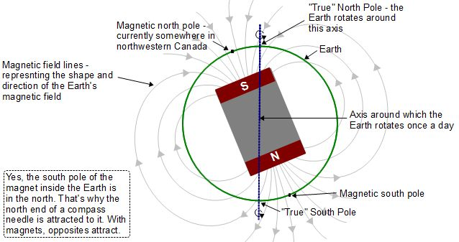

Slide 25
EARTH’S MAGNETIC FIELD TERMINOLOGY

Slide 26
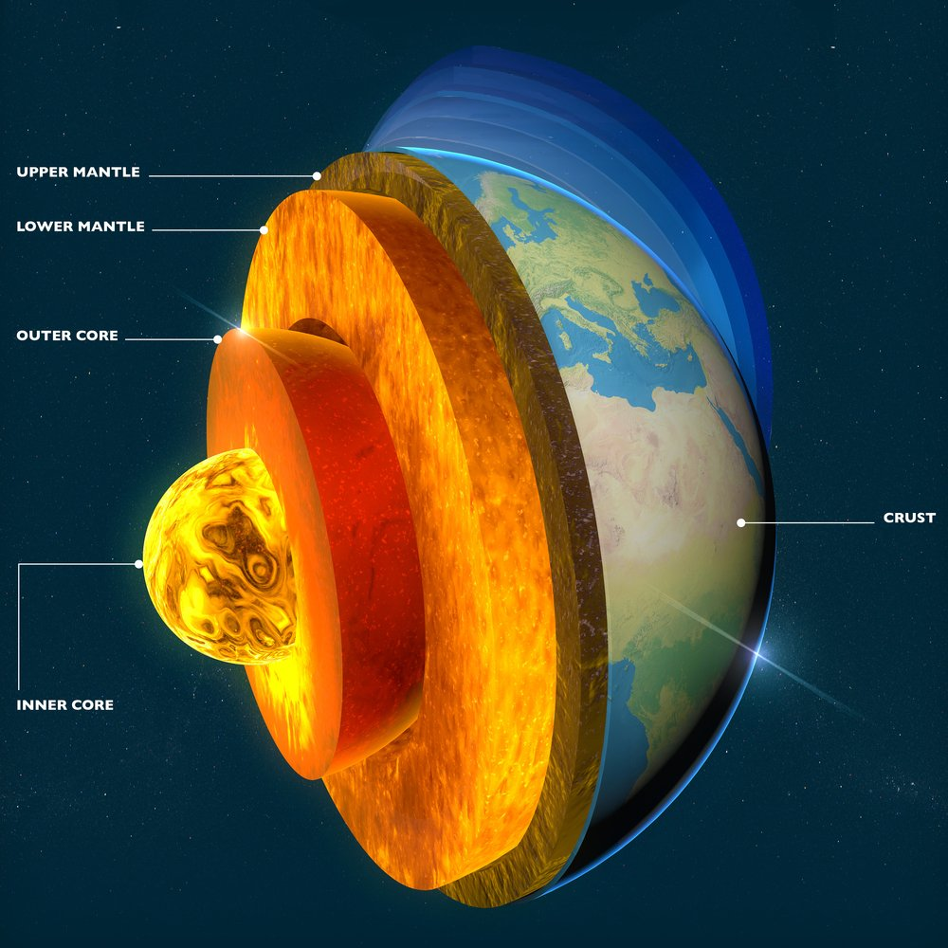
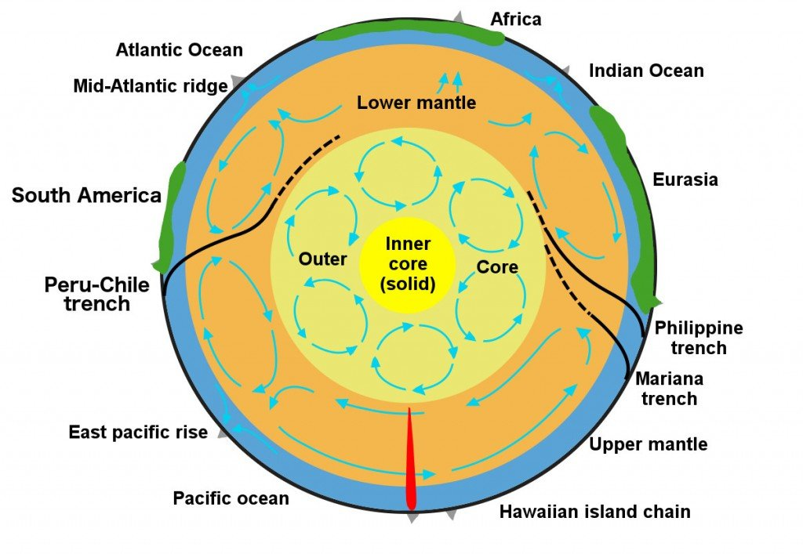
GEOMAGNETIC DYNAMO EFFECT
M = 60 μTelsa
M = 30 μTelsa

Slide 27
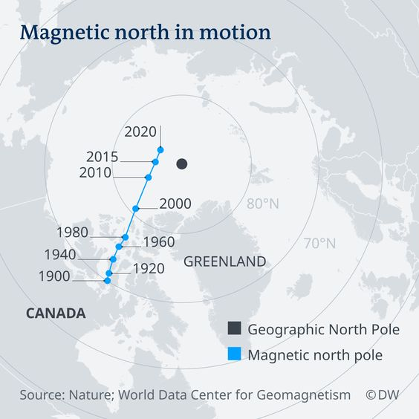
EARTH’S MAGNETIC POLES SHIFT

Slide 29
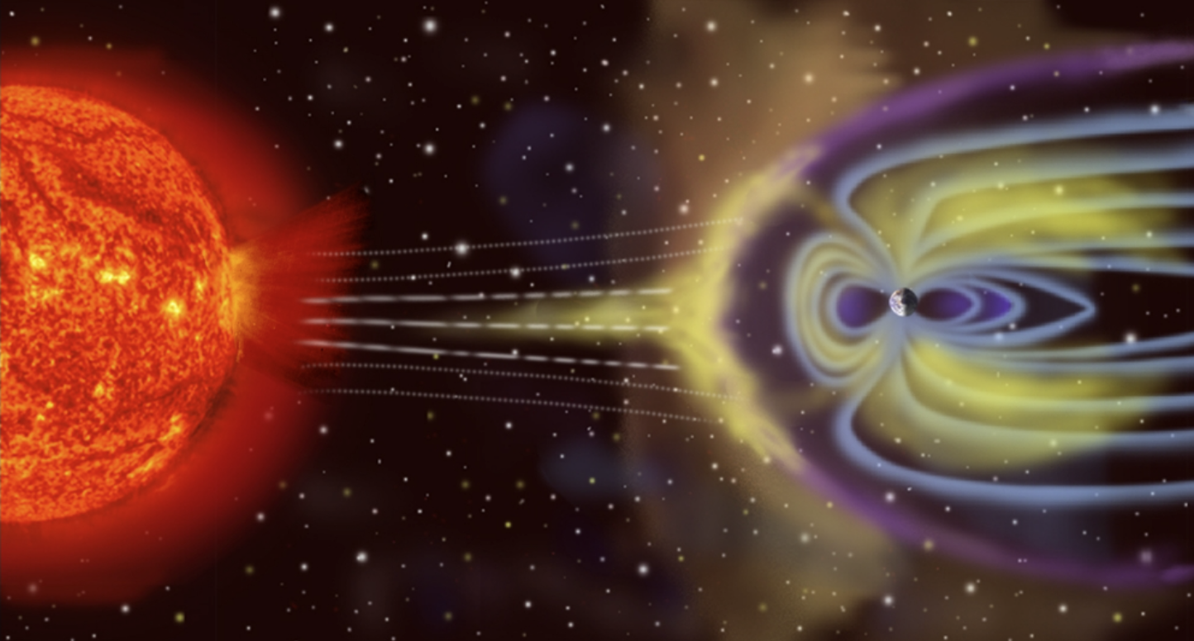
EARTH-SUN INTERACTIONS
Not to scale

Slide 30
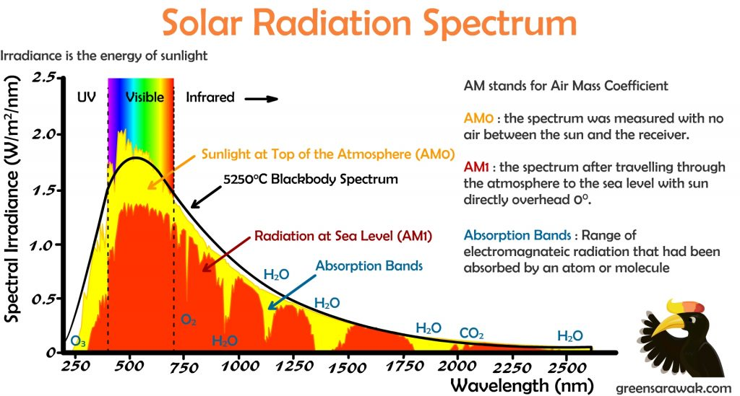

Slide 31
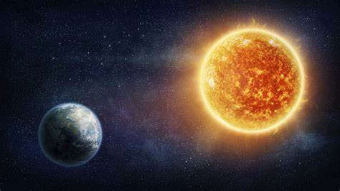


SOLAR ENERGY - IRRADIANCE
$S\left(r\right)=S_{e}{\left(\frac{au}{r}\right)}^{2}$
Where:
au = 1 AU = 149,597,871 km
r = distance from sun (m)
S = solar constant at distance r from sun $\left(\frac{W}{m^{2}}\right)$
$S_{E}$ = solar constant at 1 AU from the sun $\left(\frac{W}{m^{2}}\right)$
$S_{E}$ = 1366.1 $\left(\frac{W}{m^{2}}\right)$
(ASTM standard)

Slide 32
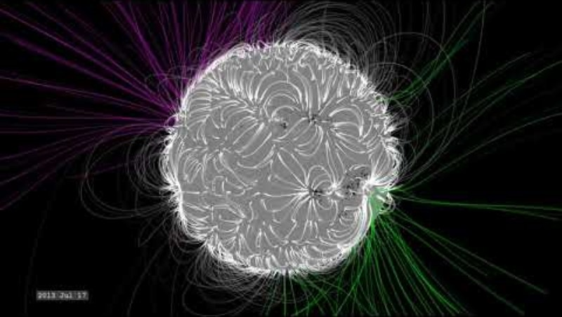
Changing of the Sun’s Magnetic Field Over Four Years

Slide 33
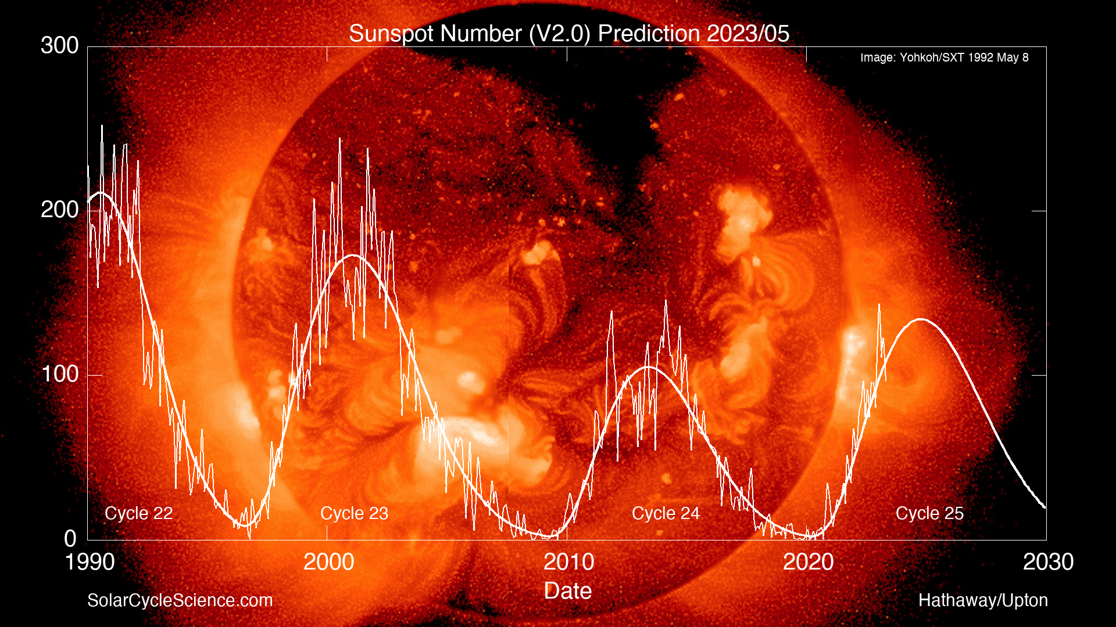
11 year solar cycle

Slide 34
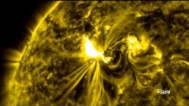
SOLAR FLARES AND CORONAL MASS EJECTIONS

Slide 35
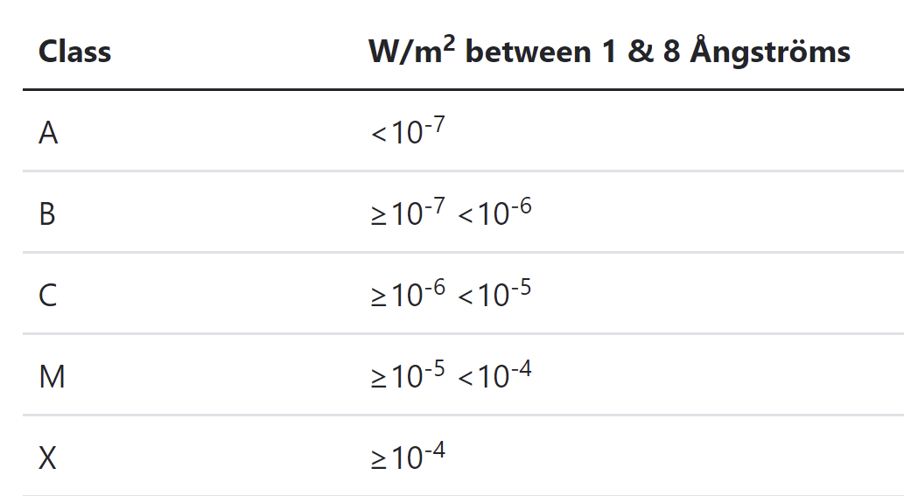
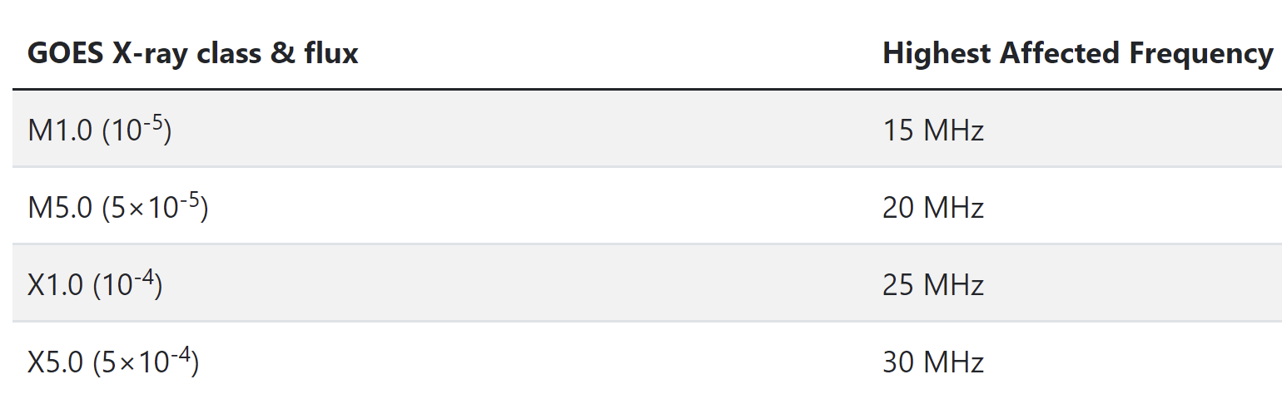
SOLAR FLARES – SPEED OF LIGHT

Slide 36
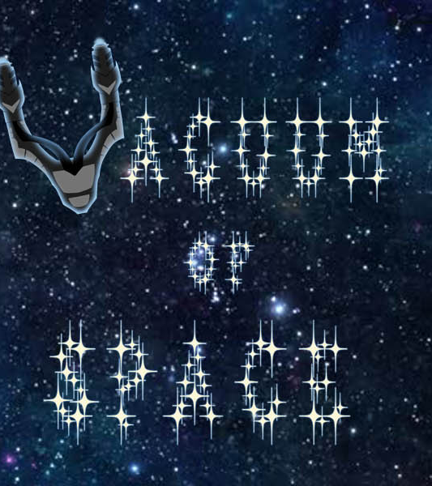
SUMMARY
INTRODUCTION TO COURSE
SPACE ENVIRONMENT
EARTH-SUN INTERACTIONS
NEXT: VACUUM ENVIRONMENT
HOMEWORK 1 DUE
INTROPROJECT & MILESTONE 1

Slide 38
REFERENCES
Dunbar, B. (November 7, 2007). Earth's Inconstant Magnetic Field. NASA. https://www.nasa.gov/vision/earth/lookingatearth/29dec_magneticfield.html.
Green Sarawak. (2014). Going Solar Chapter 2: Know your Earth. Green Sarawak. https://greensarawak.com/things-to-know-before-going-solar/going-solar-chapter-2-know-your-earth/.
Independent Scientist (July 24, 2020). North and South Pole’s Definition. https://fatinsl.info
Nace, T. (2019, December 17). Earth's Magnetic North Pole Has Officially Moved (Toward Russia). Forbes. https://www.forbes.com/sites/trevornace/2019/12/17/earths-magnetic-north-pole-has-officially-moved-toward-russia/?sh=52473186201f.
NASA. (August 18, 2002) APOD: 2002 August 18 - Earth's North Magnetic Pole. NASA. https://apod.nasa.gov/apod/ap020818.html.
Nasa. (2017, July 31). Solar Flare GIF - Nasa SolarFlare Sun - Discover & Share GIFs. Tenor. https://tenor.com/view/nasa-solar-flare-sun-flare-solar-gif-9361902.
NASA. (2020, September 10). What Is the Solar Cycle? NASA. https://spaceplace.nasa.gov/solar-cycles/en/.
NOAA. (2021). Geomagnetic Storms. Geomagnetic Storms | NOAA / NWS Space Weather Prediction Center. https://www.swpc.noaa.gov/phenomena/geomagnetic-storms#:~:text=A%20geomagnetic%20storm%20is%20a%20major%20disturbance%20of,the%20currents%2C%20plasmas%2C%20and%20fields%20in%20Earth%E2%80%99s%20magnetosphere.
NOAA (2021). Space Weather Scales. NOAA Space Weather Scales | NOAA / NWS Space Weather Prediction Center. https://www.swpc.noaa.gov/noaa-scales-explanation.
Tyler, A., Tania, Skellern, I., & Jessica. (n.d.). Home. Quill & Pad. https://quillandpad.com/2016/03/01/the-how-what-when-where-and-why-of-seeing-the-aurora-borealis-aka-northern-lights/.
US Department of Commerce, N. O. A. A. (2015, July 7). Imagery at a Glance. NOAA GOES Geostationary Satellite Server. https://www.goes.noaa.gov/.
World Data Center for Geomagnetism. Shift of the North Magnetic Pole. (n.d.). https://www.mapmania.org/map/105279/shift_of_the_north_magnetic_pole.
YouTube. (2014). Nasa | The Difference Between CMEs and Solar Flares. YouTube. https://www.youtube.com/watch?v=TWjtYSRlOUI.

